Slide 1
Amplitude Modulation Course Teacher Dr. Monir Morshed Professor, Dept. of ICT Email:monirmorshed.ict@mbstu.ac.bd

Slide 2
Modulation
Modulation is a process of varying the characteristics of RF carrier wave in accordance with a modulating signal that typically contains information that is to be transmitted.
m(t)
m(t)cosω_{c}t
Modulating signal
Modulated signal
cosω_{c}t
Carrier
Fig. Modulator
The original signal that generated from input transducer which actually we want to sent through transmitter is called Message Signal or modulating Signal or Baseband Signal.
The High Frequency Sinusoidal Signal Which is used to shift the frequency of message signal is called carrier signal.

Slide 3
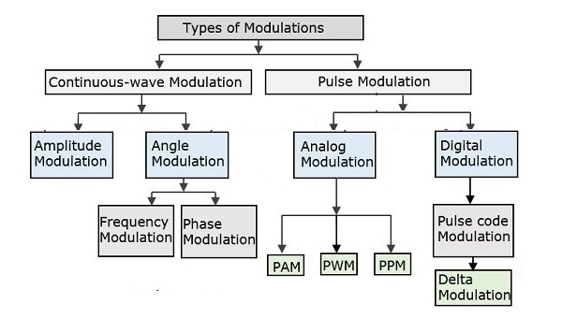
Different types of modulation systems

Slide 4
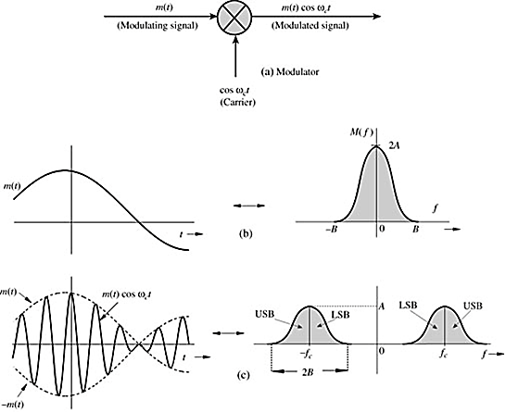

Amplitude Modulation
Amplitude Modulation is a process of varying amplitude of high frequency carrier signal in accordance with the instantaneous amplitude of the information signal and also the frequency and phase are kept constant.
$$m(t)\underset{⇔}{ }M(f)$$
$$m\left(t\right)\cos{2πf_{c}t}\underset{⇔}{ }\frac{1}{2}\left[M\left(f+f_{c}\right)+M\left(f−f_{c}\right)\right]$$
If the bandwidth of modulating signal is B Hz, then bandwidth of modulated signal is 2B Hz. The band above f_{c} is USB, and below f_{c} is LSB. Since, modulated signal does not contain discrete component of carrier frequency, it is called double side band suppressed carrier (DSB-SC).

Slide 5
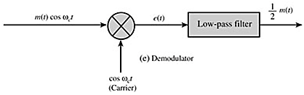
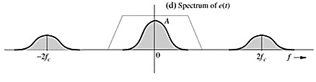



Demodulation
Demodulator: recovering the message signal at the receiver from the modulated signal.
$$e\left(t\right)=m\left(t\right)\cos^{2}ω_{c}t$$
$e\left(t\right)$ $=\frac{1}{2}\left[m\left(t\right)+m\left(t\right)cos2ω_{c}t\right]$
$$E\left(f\right)=\frac{1}{2}M\left(f\right)+\frac{1}{4}\left[M\left(f+{2f}_{c}\right)+M\left(f−{2f}_{c}\right)\right]$$

Slide 6
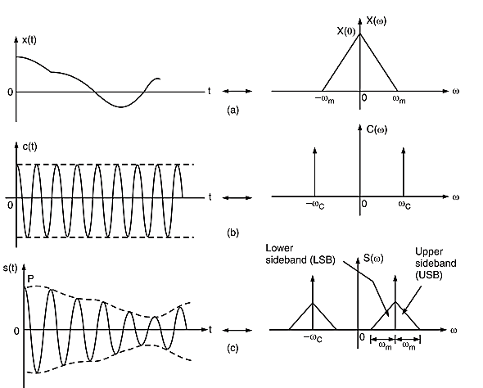



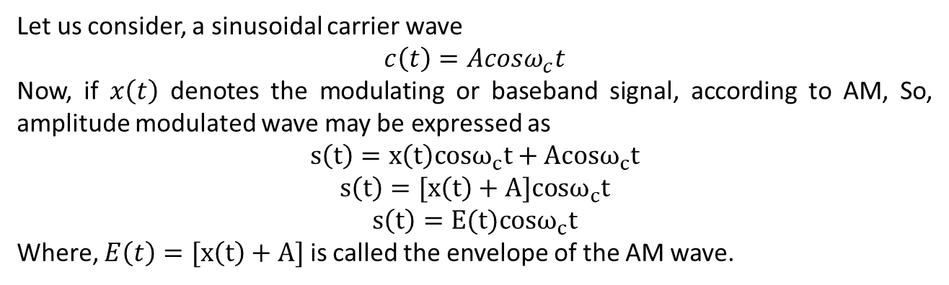
General Equation of AM and Spectrum
Let us consider, a sinusoidal carrier wave
$$c\left(t\right)=Acosω_{c}t$$
Now, if $x\left(t\right)$ denotes the modulating or baseband signal, according to AM, So, amplitude modulated wave may be expressed as
$$s\left(t\right)=x\left(t\right)cosω_{c}t+Acosω_{c}t$$
$$s\left(t\right)=[x\left(t\right)+A]cosω_{c}t$$
$$s\left(t\right)=E(t)cosω_{c}t$$
Where, $E\left(t\right)=[x\left(t\right)+A]$ is called the envelope of the AM wave.

Slide 7
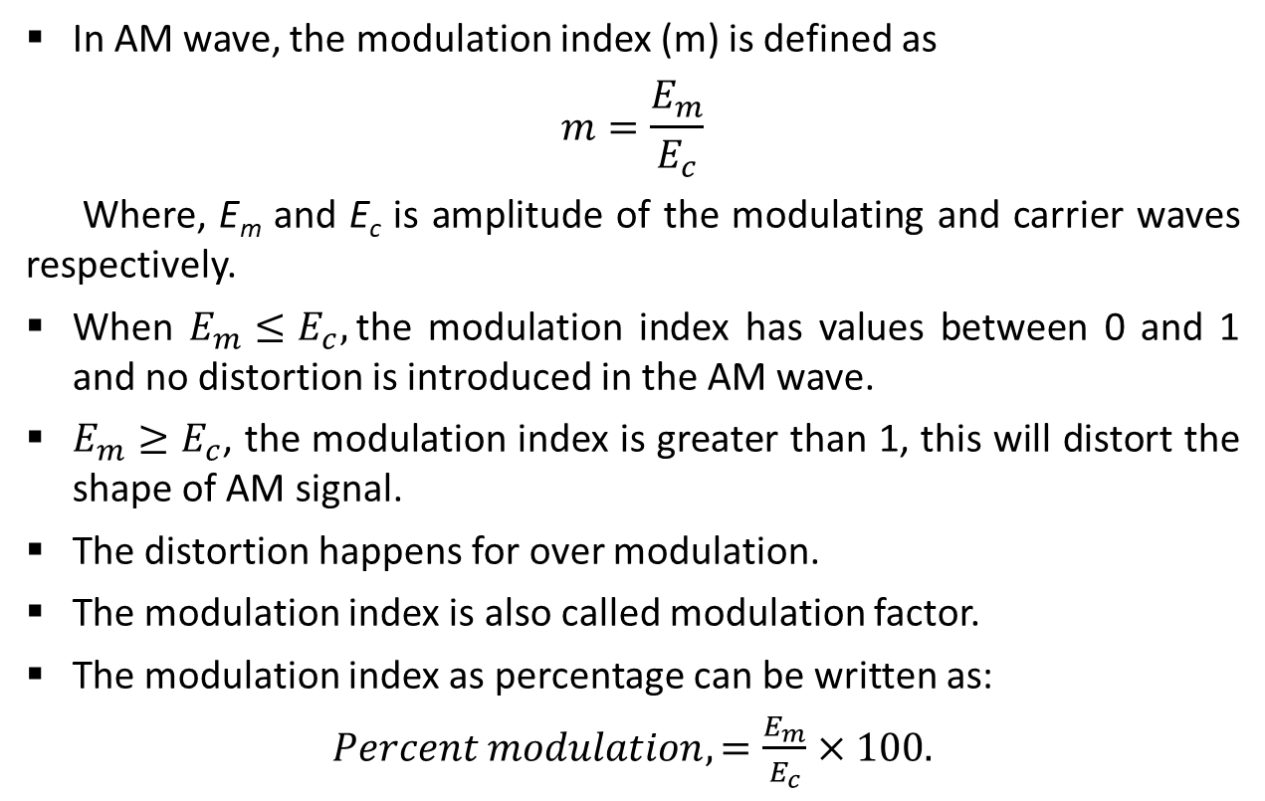
Modulation Index
In AM wave, the modulation index (m) is defined as
$$m=\frac{E_{m}}{E_{c}}$$
Where, E_{m} and E_{c} is amplitude of the modulating and carrier waves respectively.
When $E_{m}≤E_{c},$the modulation index has values between 0 and 1 and no distortion is introduced in the AM wave.
$E_{m}≥E_{c}$, the modulation index is greater than 1, this will distort the shape of AM signal.
The distortion happens for over modulation.
The modulation index is also called modulation factor.
The modulation index as percentage can be written as:
$Percent modulation,=\frac{E_{m}}{E_{c}}×100.$

Slide 8
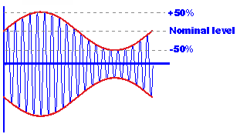
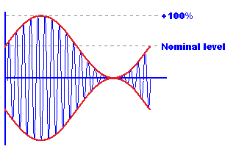
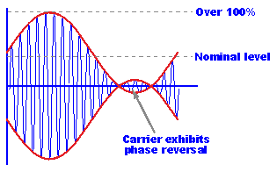



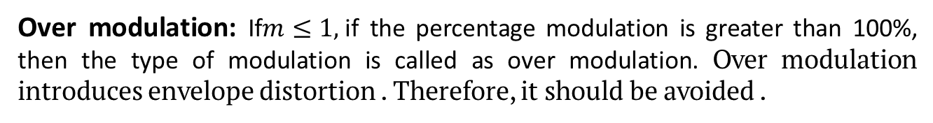
Linear and Over Modulation
Based on the values of modulation index, it can be classified as:
Linear modulation
Over modulation
Linear Modulation: If $m≤1$or if the percentage modulation is less than 100, then the type of modulation is linear amplitude modulation.
$$m≤1$$
$$m=1$$
$$m≥1$$
Over modulation: If$m≤1,$if the percentage modulation is greater than 100%, then the type of modulation is called as over modulation. Over modulation introduces envelope distortion . Therefore, it should be avoided .

Slide 9

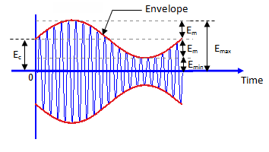






Evaluation of Modulation Index
The modulation index can be measured using the following two methods :
Using the AM signal as it is
Using the trapezoidal display of the AM wave
The AM Wave: If we see the AM wave in the cathode ray oscilloscope (CRO), it will appears to be the following figure:
Or,
But,
Hence,

Slide 10
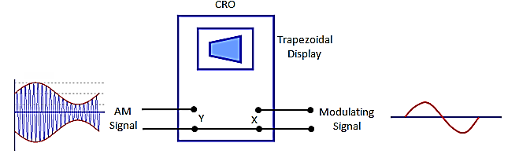




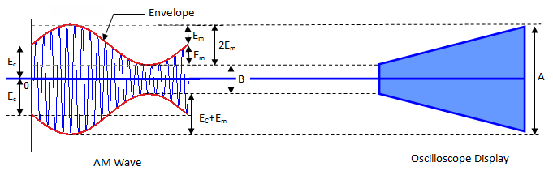



Using the trapezoidal display of the AM wave
The set up for evaluating the modulation index using trapezoidal display has been shown in the following figures:
Or,
See example 3.2, 3.3, 3.4, 3.5 of SS books.

Slide 11
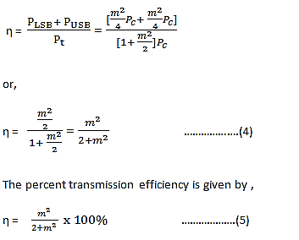

Transmission Efficiency
Transmission efficiency of an AM wave is the ratio of the transmitted power which contains the information (i.e. the total sideband power) to the total transmitted power.
The higher percentage of modulation is preferred for strong and more intelligible received signal because it increases the transmitted power P_{t} by the AM transmitter.

Slide 12
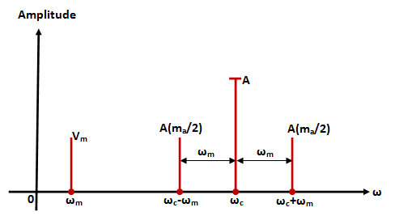
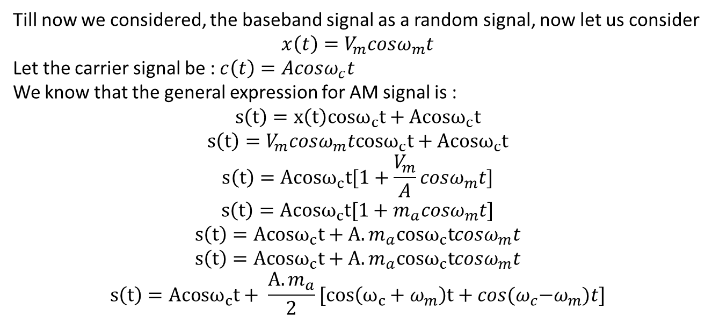
Single Tone AM
Till now we considered, the baseband signal as a random signal, now let us consider
$$x\left(t\right)=V_{m}cosω_{m}t$$
Let the carrier signal be : $c\left(t\right)=Acosω_{c}t$
We know that the general expression for AM signal is :
$$s\left(t\right)=x\left(t\right)cosω_{c}t+Acosω_{c}t$$
$$s\left(t\right)=V_{m}cosω_{m}tcosω_{c}t+Acosω_{c}t$$
$$s\left(t\right)=Acosω_{c}t[1+\frac{V_{m}}{A}cosω_{m}t]$$
$$s\left(t\right)=Acosω_{c}t[1+m_{a}cosω_{m}t]$$
$$s\left(t\right)=Acosω_{c}t+A.m_{a}cosω_{c}tcosω_{m}t$$
$$s\left(t\right)=Acosω_{c}t+A.m_{a}cosω_{c}tcosω_{m}t$$
$$s\left(t\right)=Acosω_{c}t+ \frac{A.m_{a}}{2}[cos\left(ω_{c}+ω_{m}\right)t+cos{{(ω}_{c}−ω}_{m})t]$$
See example 3.7, 3.3, 3.4, 3.5 of SS books.
Single-sided frequency spectrum of single-tone AM wave

Slide 13
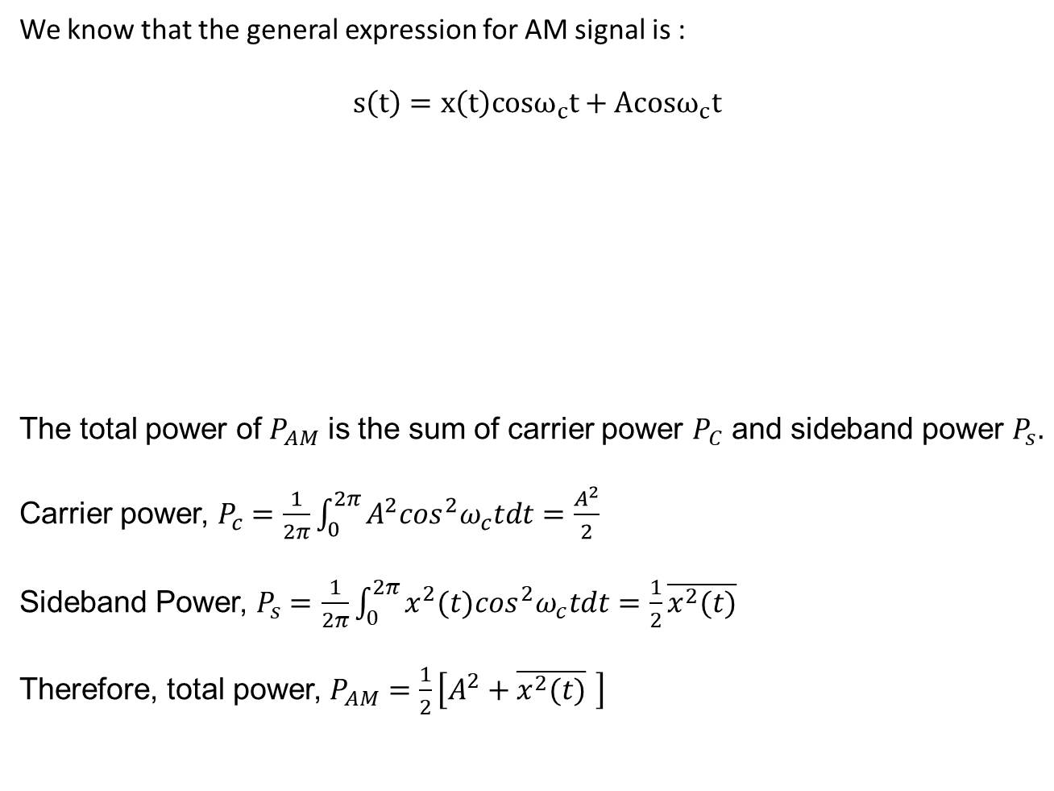
Power Content in AM Wave
We know that the general expression for AM signal is :
$$s\left(t\right)=x\left(t\right)cosω_{c}t+Acosω_{c}t$$
The total power of $P_{AM}$ is the sum of carrier power $P_{C}$ and sideband power $P_{s}.$
Carrier power, $P_{c}=\frac{1}{2π}\int_{0}^{2π}{A^{2}\cos^{2}ω_{c}tdt}=\frac{A^{2}}{2}$
Sideband Power, $P_{s}=$ $\frac{1}{2π}\int_{0}^{2π}{x^{2}(t)\cos^{2}ω_{c}tdt}=\frac{1}{2}\overline{x^{2}(t)}$
Therefore, total power, $P_{AM}=\frac{1}{2}\left[A^{2}+\overline{x^{2}(t)} \right]$
Sideband term
Carrier term only

Slide 14
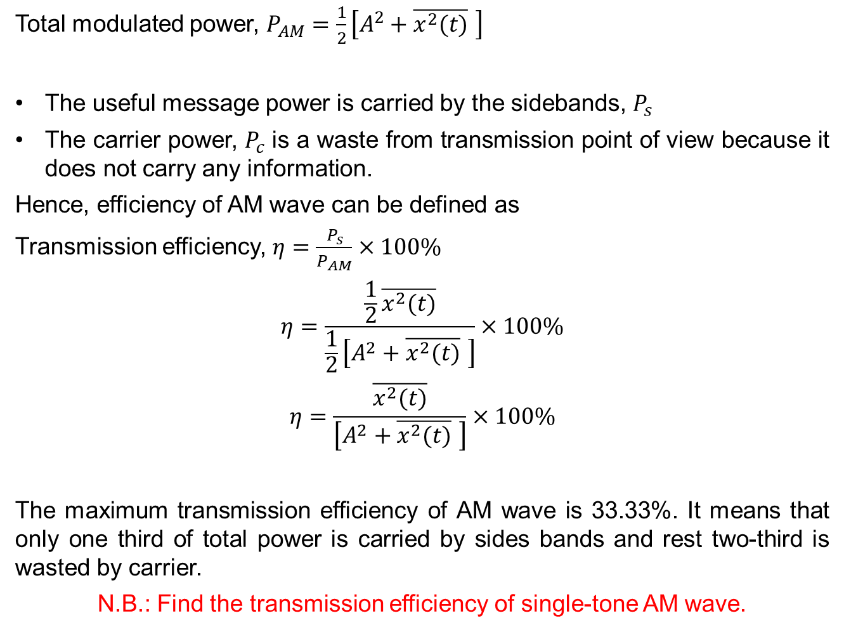
Transmission Efficiency of AM Wave
Total modulated power, $P_{AM}=\frac{1}{2}\left[A^{2}+\overline{x^{2}(t)} \right]$
The useful message power is carried by the sidebands, $P_{s}$
The carrier power, $P_{c}$ is a waste from transmission point of view because it does not carry any information.
Hence, efficiency of AM wave can be defined as
Transmission efficiency, $η=\frac{P_{s}}{P_{AM}}×100\%$
$$η=\frac{\frac{1}{2}\overline{x^{2}(t)}}{\frac{1}{2}\left[A^{2}+\overline{x^{2}(t)} \right]}×100\%$$
$$η=\frac{\overline{x^{2}(t)}}{\left[A^{2}+\overline{x^{2}(t)} \right]}×100\%$$
The maximum transmission efficiency of AM wave is 33.33%. It means that only one third of total power is carried by sides bands and rest two-third is wasted by carrier.
N.B.: Find the transmission efficiency of single-tone AM wave.

Slide 15
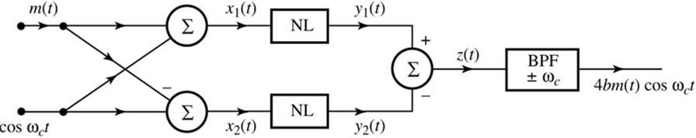

Type of Modulators
Multiplier Modulators: A variable gain amplifier in which the gain parameter (such as the β of transistor) is controlled by the message signal m(t) and the input is the carrier signal.
Difficult to maintain linearity in this kind of amplifier
It is also expensive
Nonlinear Modulators: Nonlinear devices such as diode or transistors are used to output modulated signal.
$$y\left(t\right)=ax\left(t\right)+bx^{2}(t)$$
$z\left(t\right)=y_{1}\left(t\right)−y_{2}\left(t\right)=[ax_{1}\left(t\right)+bx_{1}^{2}(t)$]-$[ax_{2}\left(t\right)+bx_{2}^{2}(t)$]
$$z\left(t\right)={2a.m\left(t\right)+4b.m\left(t\right)cosω}_{c}t$$
Single balanced modulator because one of the input does not appear at the output z(t)

Slide 16
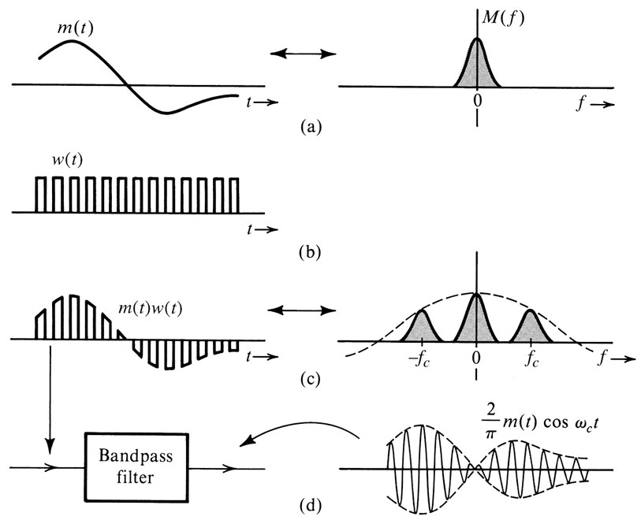
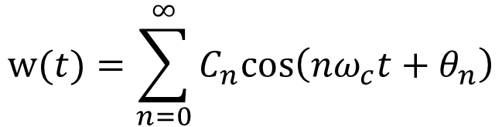
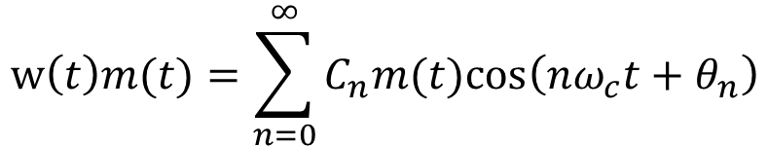
Type of Modulators
Switching Modulators
$$w(t)=\sum_{n=0}^{∞}{C_{n}cos⁡\left(nω_{c}t+θ_{n}\right)}$$
$$w\left(t\right)m(t)=\sum_{n=0}^{∞}{C_{n}m(t)cos⁡\left(nω_{c}t+θ_{n}\right)}$$
$$w\left(t\right)m\left(t\right)=\frac{1}{2}m\left(t\right)+\frac{2}{π}\left[m\left(t\right)cosω_{c}t−\frac{1}{3}m\left(t\right)cos3ω_{c}t+\frac{1}{5}m\left(t\right)cos5ω_{c}t−…\right]$$

Slide 17
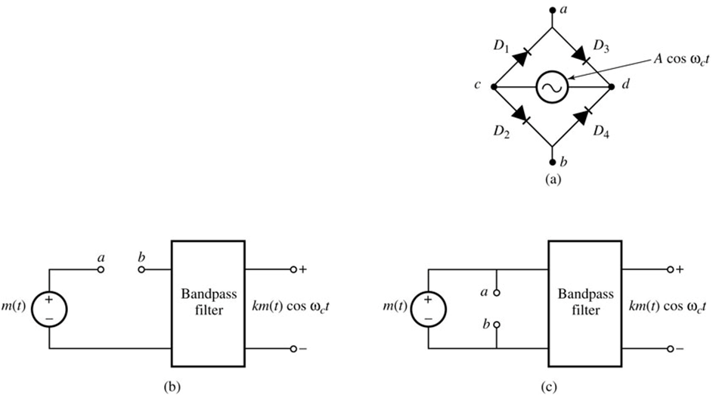
Circuit of Switching Modulators
Diode-bridge electronic switch:
When V_{c} > V_{d} all diodes are open and matched
V_{D1} = V_{D2}
V_{D1} = V_{c} – V_{a}
V_{D2} = V_{c} – V_{b}
V_{a} = V_{b}
Diode-bridge electronic switch
Series-bridge diode modulator
Shunt-bridge diode modulator

Slide 18
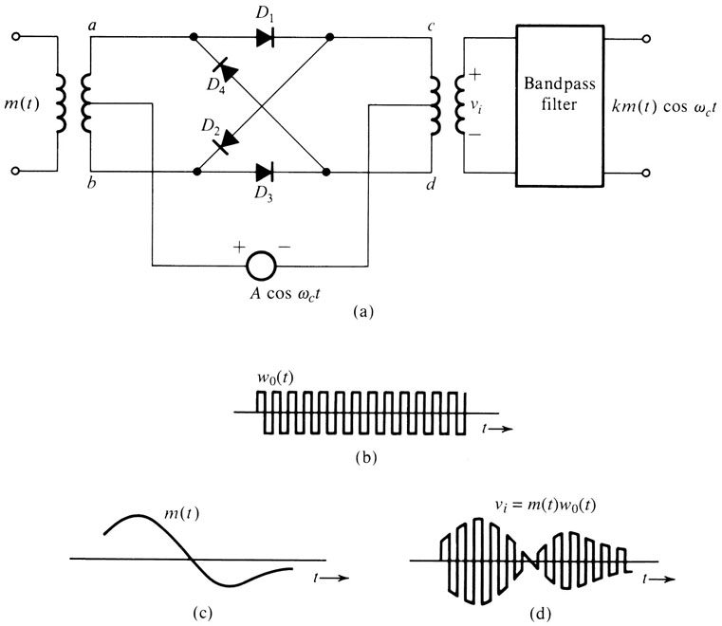
Circuit of Switching Modulators
Ring Modulator
During Positive cycle of carrier:
- D₁ & D₃ Conducts
- a connected to c & b connected to d
- output proportional to m(t)
During Negative cycle of carrier:
- D₂ & D₄ Conducts
- a connected to d & b connected to c
- output proportional to -m(t)
$$w\left(t\right)m\left(t\right)=\frac{4}{π}\left[m\left(t\right)cosω_{c}t−\frac{1}{3}m\left(t\right)cos3ω_{c}t+\frac{1}{5}m\left(t\right)cos5ω_{c}t−…\right]$$
Double Balanced Modulator

Slide 19
Demodulation of DSB-SC Signals
The DSB-SC signal may be demodulated by the following methods:
Synchronous or coherent detection method
Using envelope detector after carrier reinsertion
Challenge of coherent demodulation for DSB-SC signals
- The received signal might suffer from some unknown frequency or
phase shift.
$$r\left(t\right)=A_{c}m\left(t−t_{0}\right)cos\left[\left(ω_{c}+∆ω\right)\left(t−t_{0}\right)\right]$$
$=A_{c}m\left(t−t_{0}\right)cos\left[\left(ω_{c}+∆ω\right)t−θ_{d}\right]$
- The receiver must be sophisticated to generate a local oscillator
cos[(ω_{c}+Δω)t - θ_{d})] purely from the received signal r(t).
- Amplitude modulation (AM) that transmit the carrier with the modulated
signal will simplify the job of the receiver.

Slide 20
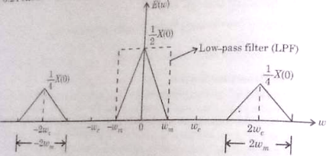
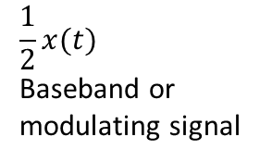


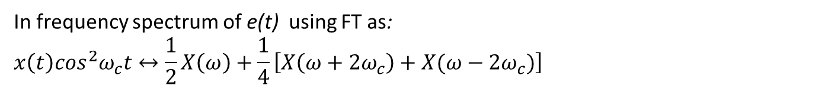
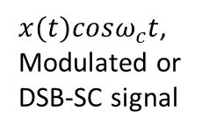
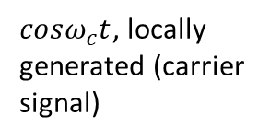

Synchronous Detection Method
It is a method of DSB-SC detection which is shown in the following figure:
$cosω_{c}t$, locally generated (carrier signal)
Receiving antenna
Multiplier
$$e(t)$$
Low pass filter (LPF)
$$\frac{1}{2}x(t)$$
Baseband or modulating signal
$x(t)cosω_{c}t$,
Modulated or DSB-SC signal
$$=x(t)\cos^{2}ω_{c}t$$
$$\acute{e}(t)$$
Mathematically, $e\left(t\right)=x(t)cosω_{c}t$. $cosω_{c}t$
$=x\left(t\right)\cos^{2}ω_{c}t=\frac{1}{2}x\left(t\right).2\cos^{2}ω_{c}t=\frac{1}{2}x\left(t\right)+\frac{1}{2}x\left(t\right)cos2ω_{c}t$
When e(t) is passed trhough a LPF, $\acute{e}\left(t\right)=\frac{1}{2}x(t)$
In frequency spectrum of e(t) using FT as:
$$x\left(t\right)\cos^{2}ω_{c}t↔\frac{1}{2}X\left(ω\right)+\frac{1}{4}\left[X\left(ω+2ω_{c}\right)+X(ω−2ω_{c})\right]$$

Slide 21
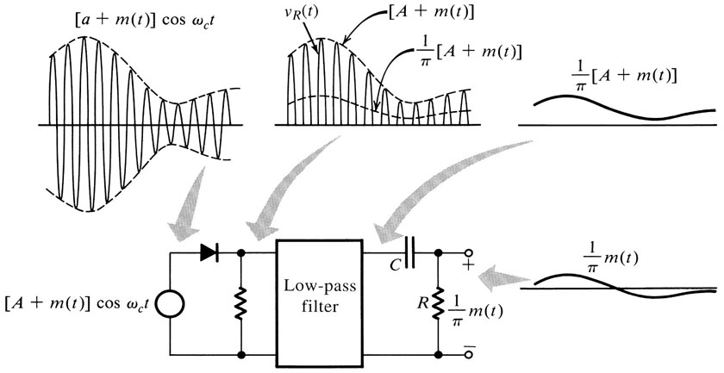

Envelope Detection
Rectifier
$$v_{r}\left(t\right)=\left\{\left[A+m(t)\right]cosω_{c}t\right\}w\left(t\right)$$
$$=\left[A+m(t)\right]cosω_{c}t\left[\frac{1}{2}+\frac{2}{π}\left(cosω_{c}t−\frac{1}{3}cos3ω_{c}t+\frac{1}{5}cos5ω_{c}t−…\right)\right]$$
$$=\frac{1}{π}\left[A+m(t)\right]+\text{other} \text{terms} \text{of} \text{higher} \text{frequencies}$$

Slide 22
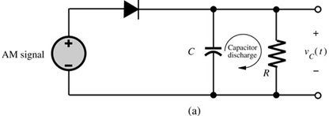
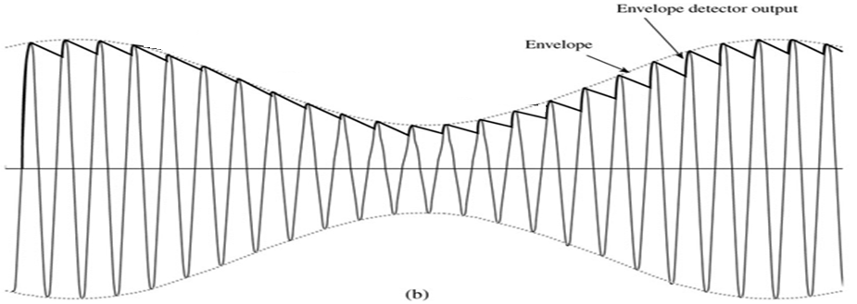


Envelope Detection
RC too large
$${1/f}_{c}≪RC<1/(B)$$
$$B<1/RC<f_{c}$$

Slide 23
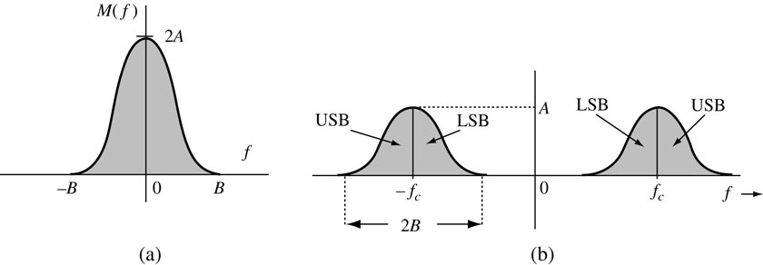
Bandwidth-Efficient Amplitude Modulations
The bandwidth of Amplitude Modulation is 2B Hz.
How to reduce bandwidth?
Single-Sideband (SSB) modulation, which remove either the LSB or the USB so that for one message signal m(t), there is only a bandwidth of B Hz.
Quadrature Amplitude (QAM) modulation, which utilize spectral redundancy by sending two messages over the same bandwidth, 2B Hz .

Slide 24
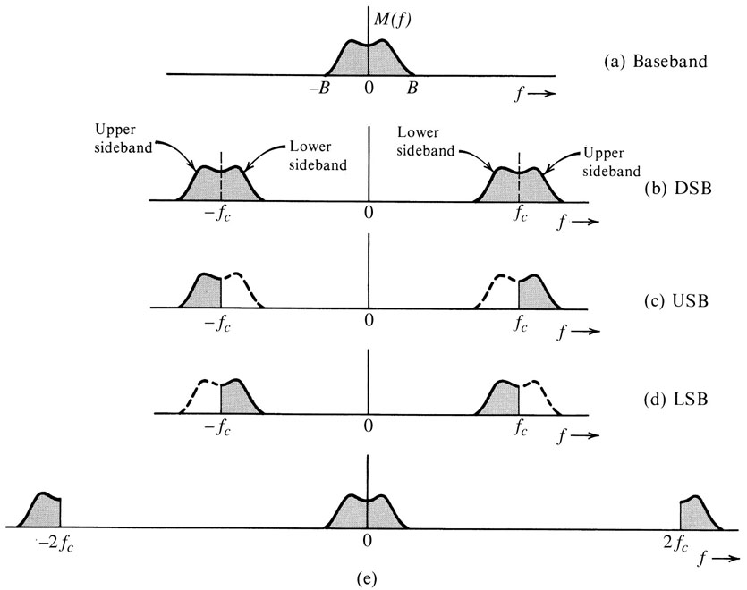
Amplitude Modulation: Single Sideband (SSB)
Single-Sideband (SSB) modulation, use Hilbert transform to remove the LSB or USB.

Slide 25
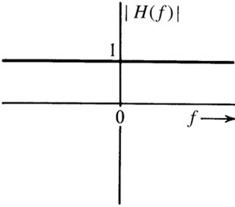
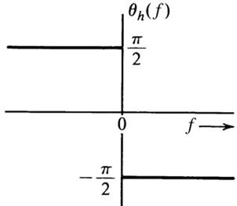



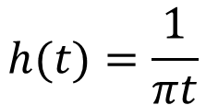
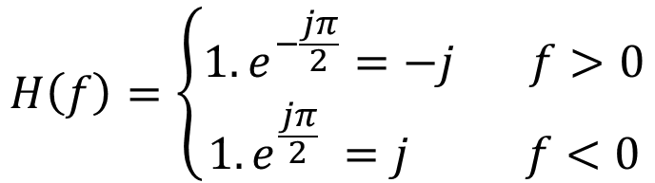
Hilbert Transform
Hilbert transform is an ideal phase shifter that shifts the phase of every positive spectral component by -π/2.
Hilbert Transform
h(t)
H(f)
m(t)
m_{h}(t)
M(f)
M_{h}(f)
$$H\left(f\right)=\left\{\begin{matrix}1.e^{−\frac{jπ}{2}}=−j f>0 \\ 1.e^{\frac{jπ}{2}} =j f<0\end{matrix}\right.$$
$$h(t)=\frac{1}{πt}$$
$$H\left(f\right)=−j sgn(f)$$
$$m_{h}\left(t\right)=m\left(t\right)∗h(t)$$
$$M_{h}\left(f\right)=−j sgn\left(f\right)M(f)$$

Slide 26
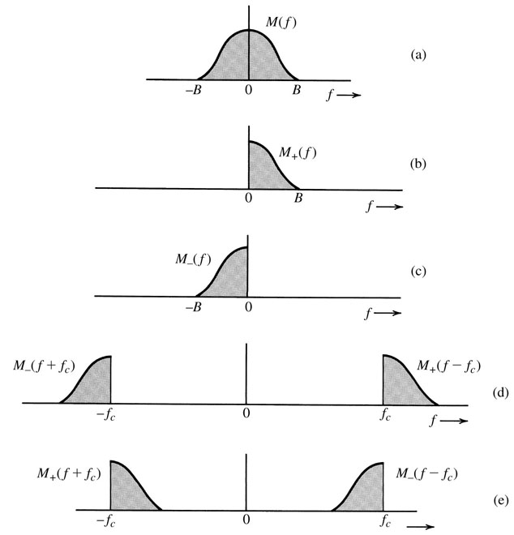


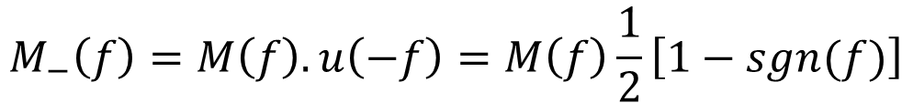
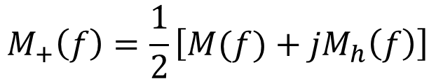
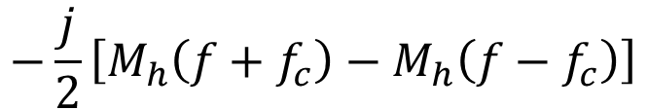
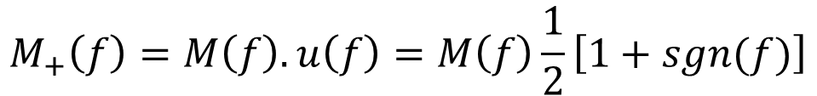
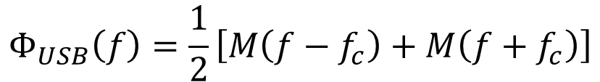
Time Domain Representation of SSB Signals
$$M_{+}\left(f\right)=M\left(f\right).u\left(f\right)=M\left(f\right)\frac{1}{2}\left[1+sgn(f)\right]$$
$$M_{+}\left(f\right)=\frac{1}{2}\left[M(f)+{jM}_{h}\left(f\right)\right]$$
$$M_{−}\left(f\right)=M\left(f\right).u\left(−f\right)=M\left(f\right)\frac{1}{2}\left[1−sgn(f)\right]$$
$M_{−}\left(f\right)$ $=\frac{1}{2}\left[M\left(f\right)−{jM}_{h}\left(f\right)\right]$
$$Φ_{USB}\left(f\right)=M_{+}\left(f−f_{c}\right)+M_{−}\left(f+f_{c}\right)$$
$$Φ_{USB}\left(f\right)=\frac{1}{2}\left[M\left(f−f_{c}\right)+M\left(f+f_{c}\right)\right]$$
$$−\frac{j}{2}\left[M_{h}\left(f+f_{c}\right)−M_{h}\left(f−f_{c}\right)\right]$$
$$φ_{USB}\left(t\right)={m\left(t\right) cosω}_{c}t−m_{h}\left(t\right) {sinω}_{c}t$$
$$φ_{LSB}\left(t\right)={m\left(t\right) cosω}_{c}t+m_{h}\left(t\right) {sinω}_{c}t$$

Slide 27
Coherent Demodulation of SSB-SC
$$φ_{SSB}\left(t\right)2cos⁡ω_{c}t={[m\left(t\right) cosω}_{c}t∓m_{h}\left(t\right) {sinω}_{c}t]2cos⁡ω_{c}t$$
$$={m\left(t\right) [1+cos2ω}_{c}t]∓m_{h}\left(t\right) {sin2ω}_{c}t$$
$$={m\left(t\right)+[m\left(t\right)cos2ω}_{c}t∓m_{h}\left(t\right) {sin2ω}_{c}t]$$
These terms can be filtered out by using low-pass filter

Slide 28
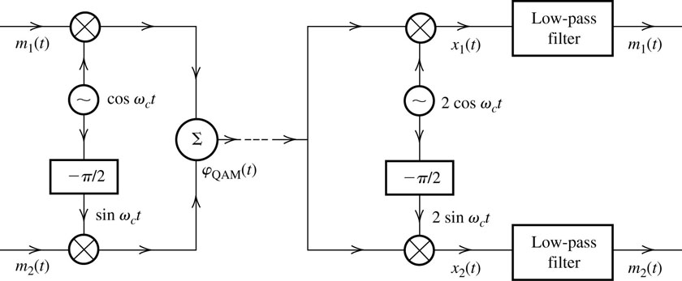
Quadrature Amplitude Modulation (QAM)
It is difficult to generate accurately SSB-SC and requires large power A >>|m(t)|, so QAM offers an attractive alternative.
QAM operates by transmitting two DSB signals via carrier of the same frequency but in phase quadrature.
Transmitter
Receiver
$$φ_{QAM}\left(t\right)={m_{1}\left(t\right)cosω}_{c}t+m_{2}\left(t\right) {sinω}_{c}t$$

Slide 29

Quadrature Amplitude Demodulation
In-phase channel
Quadrature channel
$$φ_{QAM}\left(t\right)={m_{1}\left(t\right)cosω}_{c}t+m_{2}\left(t\right) {sinω}_{c}t$$
$$x_{1}\left(t\right)=2{φ_{QAM}\left(t\right)cosω}_{c}t$$
$$={[{m_{1}\left(t\right)cosω}_{c}t+m_{2}\left(t\right) {sinω}_{c}t ]2cosω}_{c}t$$
$$={m_{1}\left(t\right)+m_{1}\left(t\right)cos2ω}_{c}t+m_{2}\left(t\right) {sin2ω}_{c}t$$
$$x_{2}\left(t\right)={m_{2}\left(t\right)−m_{2}\left(t\right)cos2ω}_{c}t+m_{1}\left(t\right) {sin2ω}_{c}t$$

Slide 30
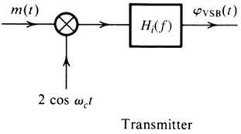
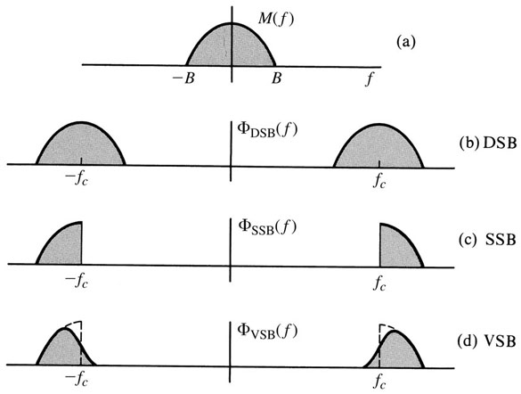
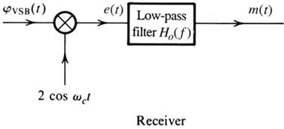
Amplitude Modulations: Vestigial Sideband (VSB)
VSB signals are relatively easy to generate, and their bandwidth is typically 25% greater than that of SSB signals.
$$Φ_{VSB}\left(f\right)=\left[M\left(f+f_{c}\right)+M\left(f−f_{c}\right)\right]H_{i}(f)$$

Slide 31
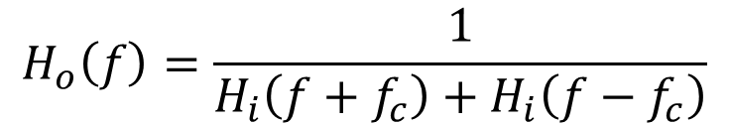

Demodulation of Vestigial Sideband (VSB)
$$Φ_{VSB}\left(f\right)=\left[M\left(f+f_{c}\right)+M\left(f−f_{c}\right)\right]H_{i}(f)$$
⁻⁻⁻⁻⁻⁻⁻⁻⁻⁻⁻> 1
$$M(f)=\left[Φ_{VSB}\left(f+f_{c}\right)+Φ_{VSB}\left(f−f_{c}\right)\right]H_{o}(f)$$
Substitute equation 1 and filter out spectra at ± 2 f_{c}
M$\left(f\right)=M(f)\left[H_{i}\left(f+f_{c}\right)+H_{i}\left(f−f_{c}\right)\right]H_{o}(f)$
$$H_{o}\left(f\right)=\frac{1}{H_{i}\left(f+f_{c}\right)+H_{i}\left(f−f_{c}\right)}$$
| f | ≤ B

Slide 32


Demodulation of Vestigial Sideband (VSB)
Example: The carrier frequency of a certain VSB signals is f_{c} = 20 kHz, and the baseband signal bandwidth is 6 kHz. The VSB shaping filter H_{i}(f) at the transmitter is shown below, find the filter H₀(f) at the receiver for distortionless reception.
$$H_{o}\left(f\right)=\frac{1}{H_{i}\left(f+f_{c}\right)+H_{i}\left(f−f_{c}\right)}$$
For envelope demodulation, VSB+C require larger carrier than DSB+C but less than SSB+C.

Slide 33

Use of VSB in Broadcast Television
TV Broadcasting
Bandwidth 4.5 MHz
Has sizable power in the low-frequency region
Envelope detector is used instead of synchronous to reduce the cost of the receiver.
BW for SSB = 4.5 MHz
BW for DSB = 9 MHz
BW for VSB = 6 MHz

Slide 34

Comparison among DSB, SSB, and VSB

